Slide 1
Dataset Analysis of accidents
Miguel Lopez

Slide 2
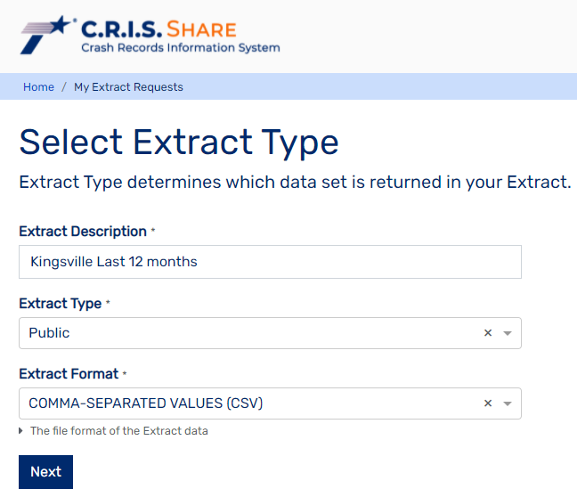
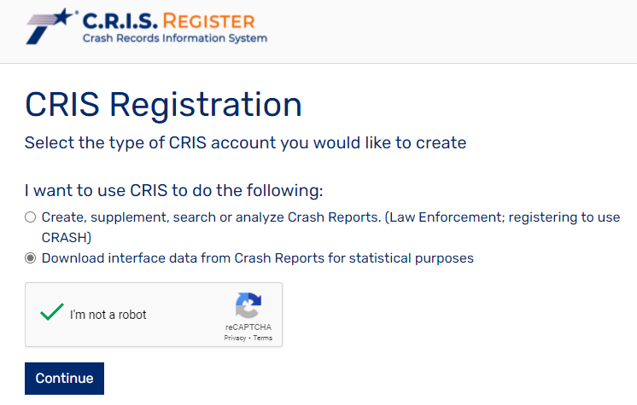
How to get the data?

Slide 3
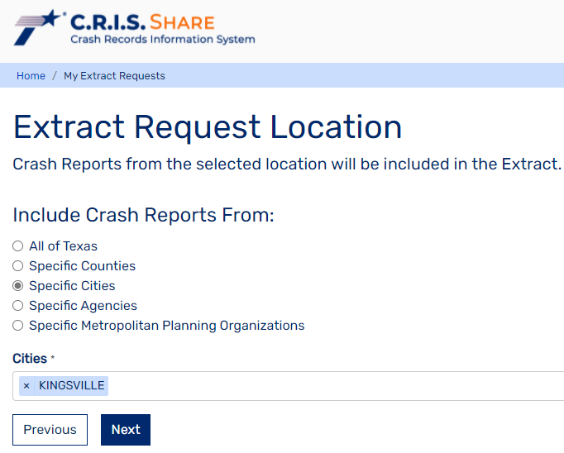
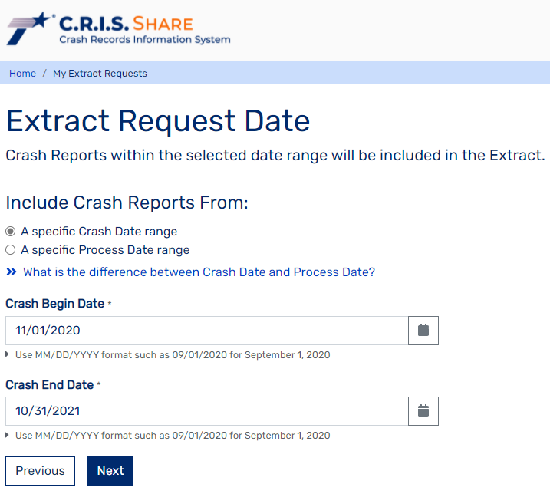
How to get the data?

Slide 4
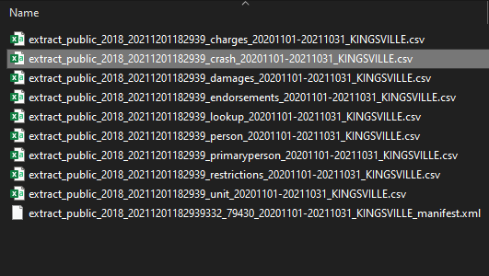
We have some data, now what?
Only used ‘crash’ and ‘primaryperson’ files
‘damages’, ‘endorsements’, ‘restrictions’, ‘unit’ low priority.
‘charges’, ‘person’ could be useful
‘lookup’ used to decipher codes

Slide 5
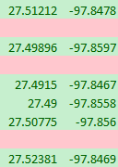
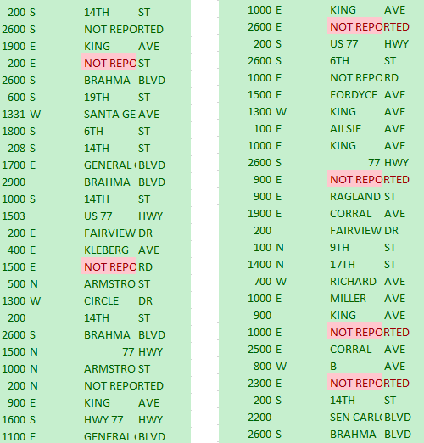
Clean the data!
Missing values!
Coordinate retrieval function (broken)
Program left to drop rows without coordinates
Saved used data to a new csv

Slide 6
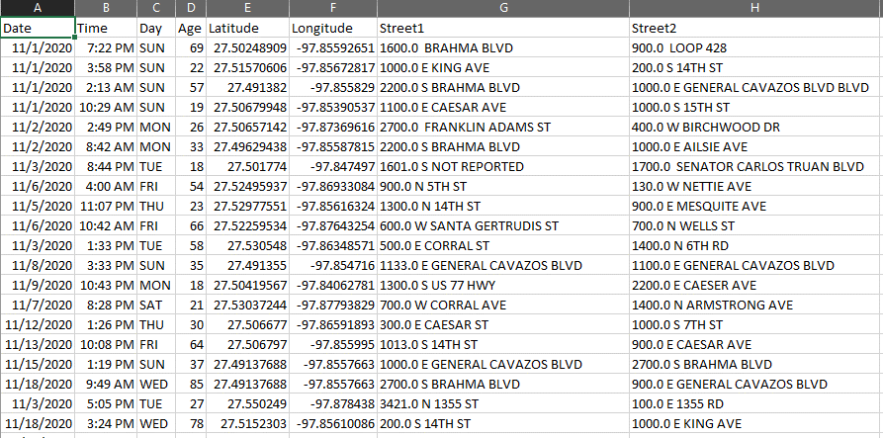
What does our reformatted csv look like?
Light on attributes maybe?

Slide 7
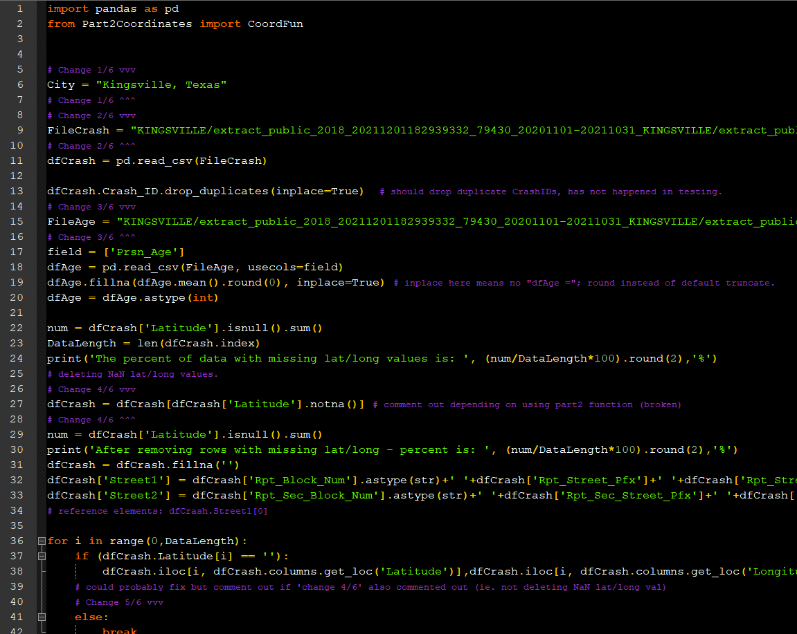
Code

Slide 8
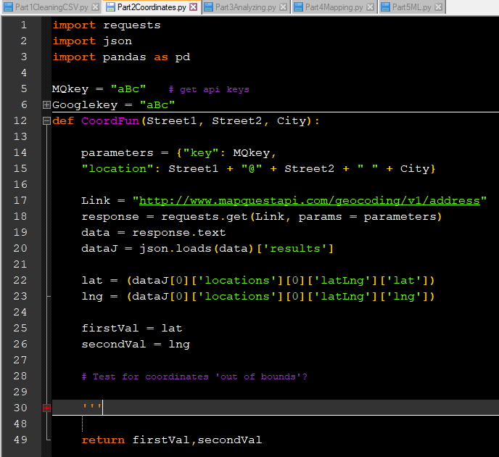
Code
Usually works..
Main error was same coordinate was given no matter input
Sometimes gave coordinates far away

Slide 9
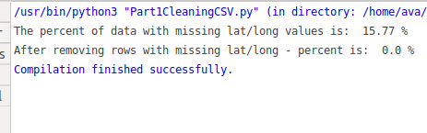
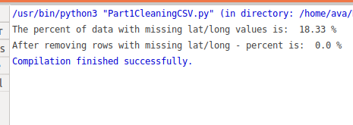
Workaround for missing coordinates
Kingsville Data
Drop rows with missing coordinates.
Estimate 15-20% of data could be missing the ‘official’ coordinates
Laredo Data

Slide 10
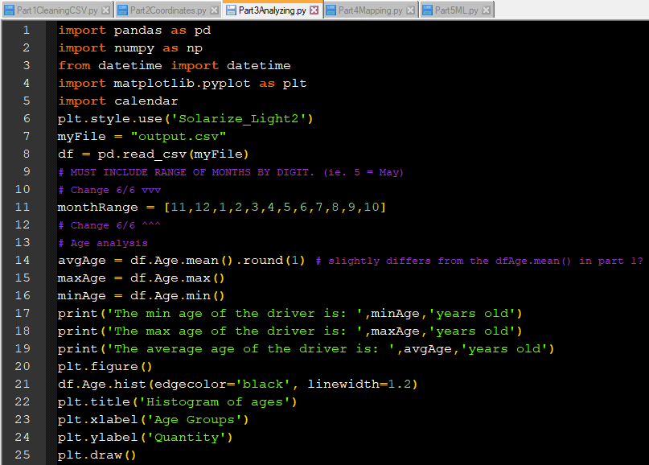

Part 3 – Analyzing!

Slide 11
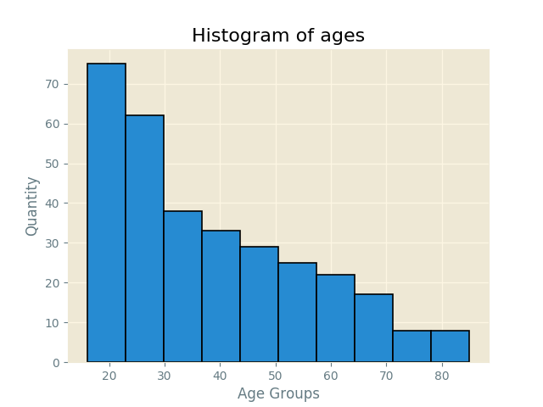
Part 3 – analyzing!

Slide 12
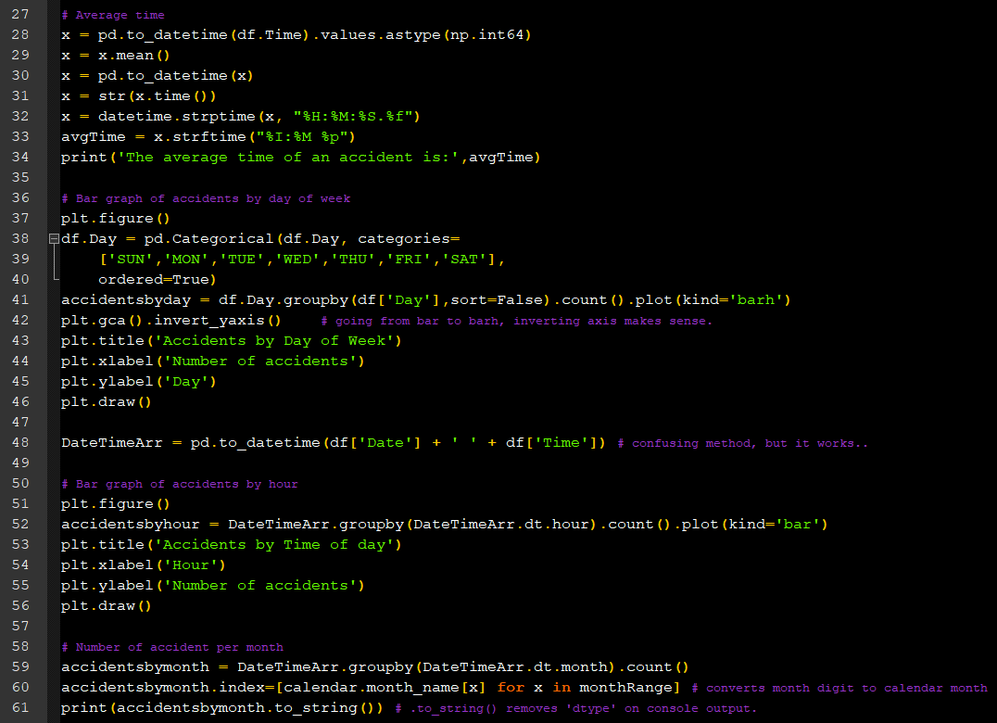
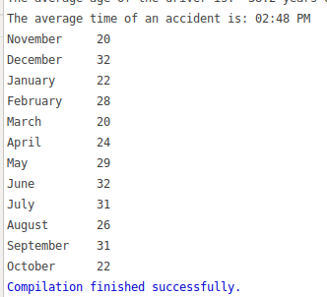
Part 3 – Analyzing!

Slide 13
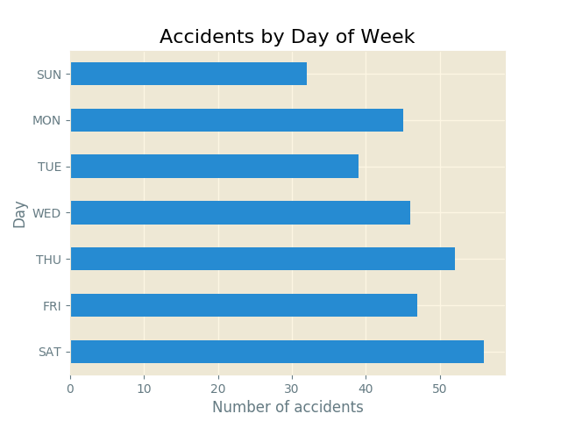
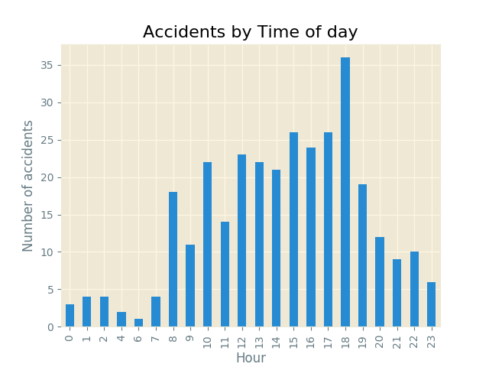
Part 3 – Analyzing!

Slide 14
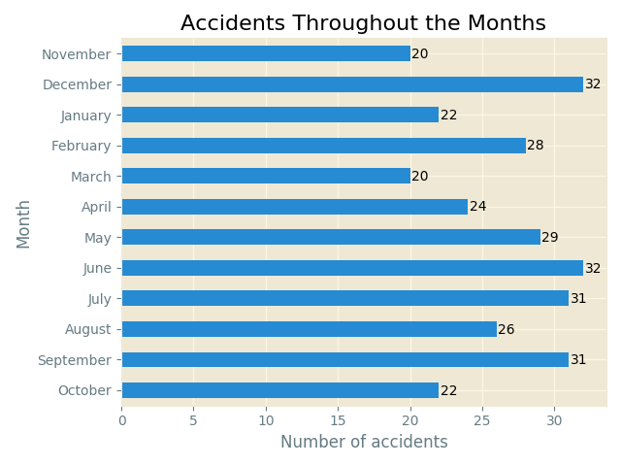
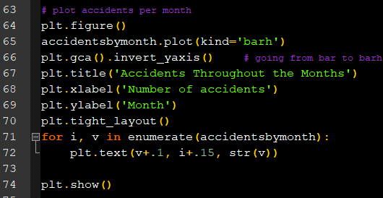
Part 3 – Analyzing!

Slide 15
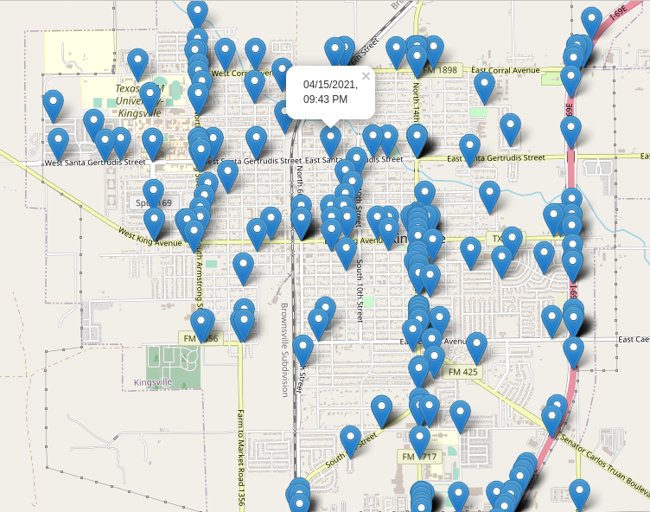
Part 4 – mapping!

Slide 16
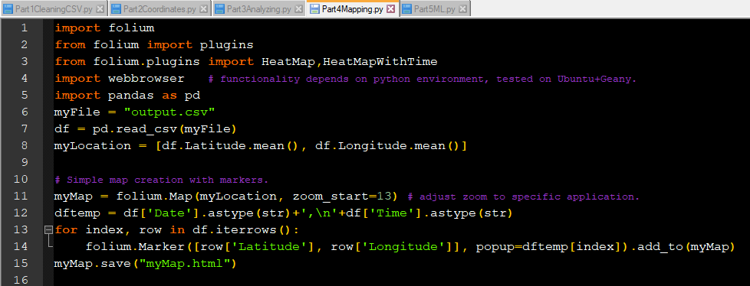
Part 4 – Mapping!

Slide 17
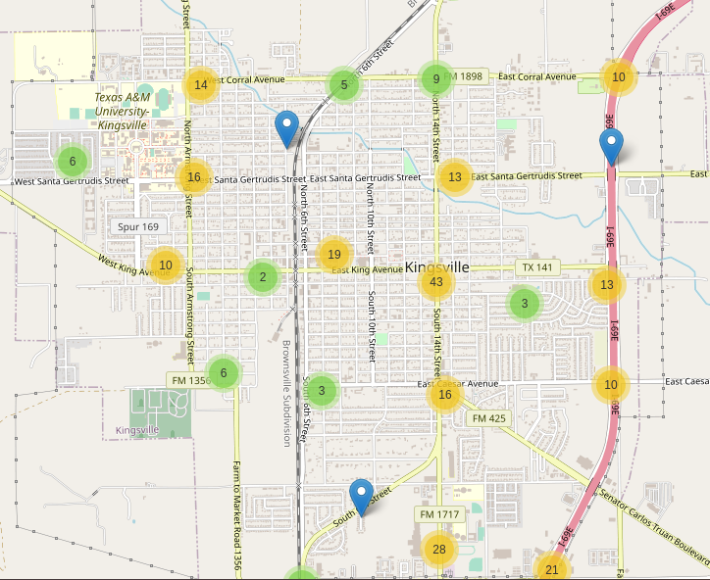
Part 4 – Mapping!

Slide 18
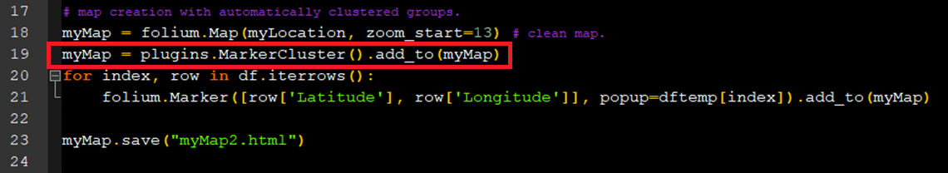
Part 4 – Mapping!

Slide 19
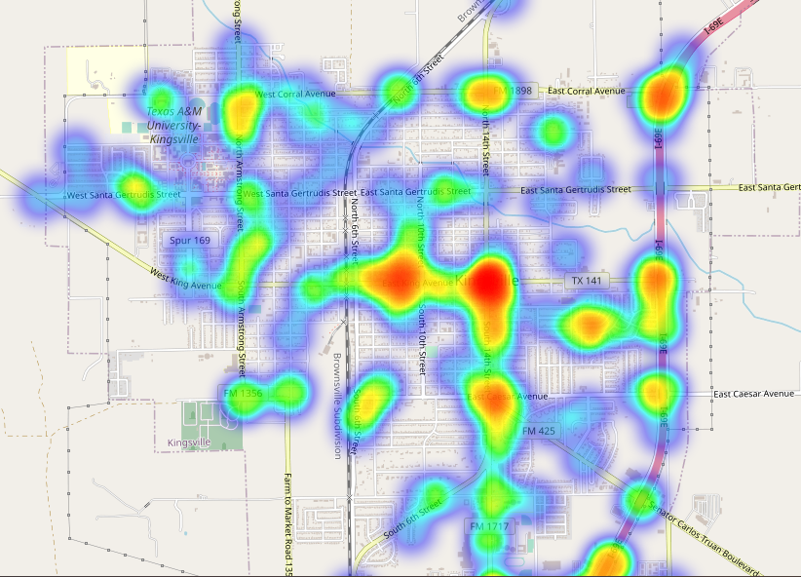
Part 4 – Mapping!

Slide 20
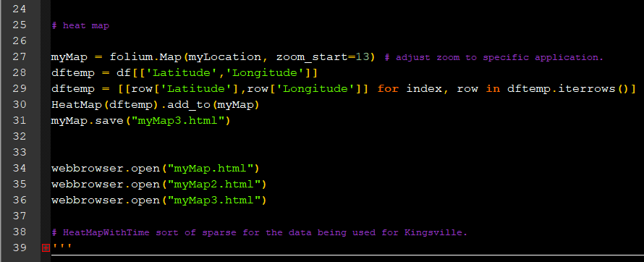
Part 4 – Mapping!

Slide 21
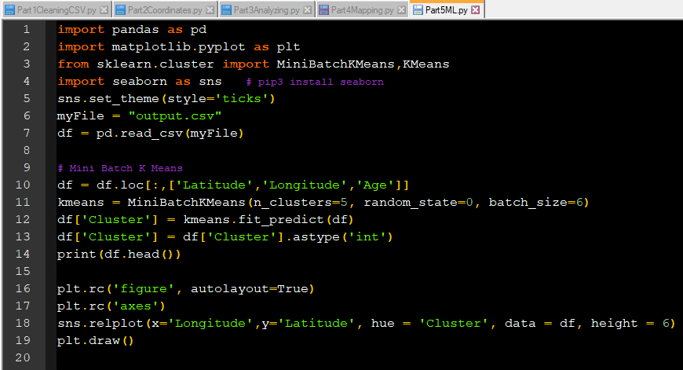
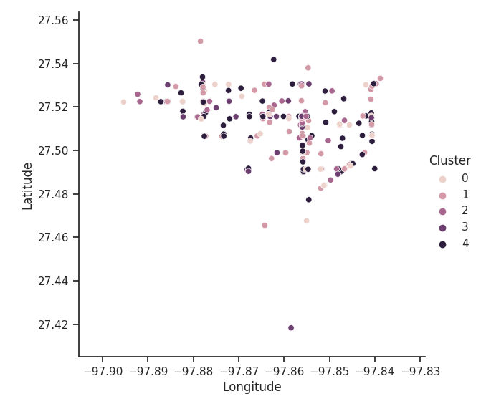
Part 5 – Machine Learning Attempt

Slide 22
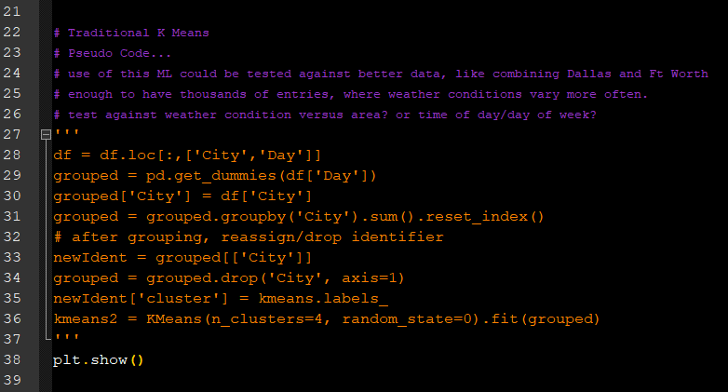
Part 5 – Machine Learning Application?

Slide 23
Future work? - Conclusions
Could be redone/rehashed with good methods
Coordinate retrieval solution could still be worked on
Work on reliability of output; alternative API?
Would benefit from bigger dataset
Variations in weather to analyze influences on accidents
ML algorithms can handle the big data
Confusing studying data based on counts versus x with y data
Satisfied with useful functionality

Slide 24
Thank you!

